Slide 1
Knoxx Outbound Intelligence
AI-powered account research, ingredient qualification and safe outreach
TECHNICAL INTERVIEW CASE STUDY
Rochak Singhal
One company per run · evidence before judgment · humans approve outreach
KNOXX OUTBOUND INTELLIGENCE
01

Slide 2
PRODUCT DEFINITION
A decision system—not an email generator
Research is fragmented
Qualification comes first
Control remains explicit
Websites, PDFs, spreadsheets and contact tools make sales research slow and hard to audit.
The system decides whether an account deserves enrichment and outreach before spending credits or rep time.
AI proposes judgments. Code owns identity, formulas, thresholds, approval, sending and stop rules.
domain
→
evidence
→
ingredient fit
→
committee
→
draft
→
approval
→
engagement
→
stop
One account may have many immutable research runs.
KNOXX OUTBOUND INTELLIGENCE
02

Slide 3
USER · JOB · OUTCOME
Success is better prioritization—not more automated email
PRIMARY USER
JOB TO BE DONE
NORTH-STAR CANDIDATE
Salesperson or business-development manager deciding where to spend research and outreach time.
Decide if an account is worth pursuing, show why, identify who matters, recommend the next action and know when to stop.
Sales-accepted qualified accounts per research hour—not email volume.
PILOT OUTCOME
MEASURE
GUARDRAILS
Speed
Median research minutes per reviewed account
Zero unintended recipients Zero unsupported golden-case claims 100% stop/suppression tests Human approval
Precision
% qualified accounts accepted by sales
Trust
Citation coverage + unsupported-claim rate
Economics
Cost per completed and accepted account
Baseline targets with sales in a controlled pilot; do not invent impact numbers in advance.
KNOXX OUTBOUND INTELLIGENCE
03

Slide 4
DISCOVERY
Assumptions made vs. questions sales must answer
STAGE
DEMO ASSUMPTION
PRODUCTION QUESTION
ICP
Prepared-food manufacturers
What makes an account unquestionably valuable?
Catalogue
6 synthetic SKUs
Which SKUs, capacity, MOQ and claims are approved?
Demand
Meals × share × kg/meal
What uncertainty and volume floor are acceptable?
Committee
Procurement, NPD, ops
Who champions, approves, buys and blocks?
Outreach
Days 0 / 3 / 7 / 12
Which CTA, proof and stop conditions are approved?
The product is configurable only after sales policy is explicit and versioned.
KNOXX OUTBOUND INTELLIGENCE
04

Slide 5
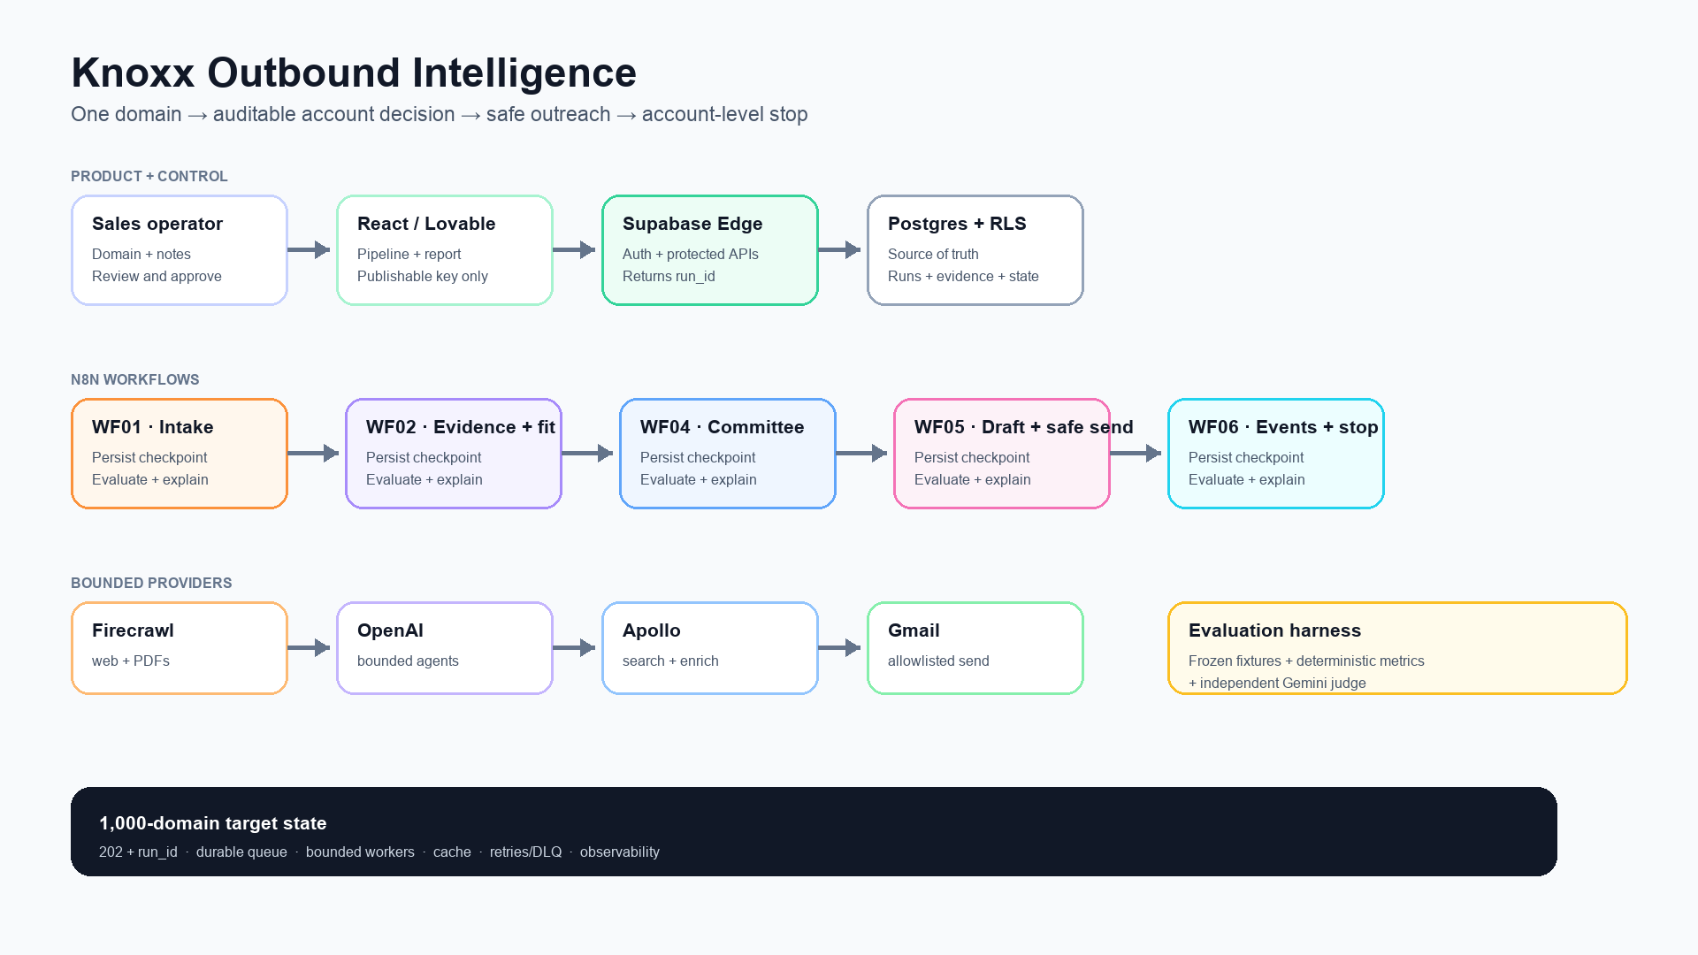
RAW DOMAIN TO COMPLETED DATABASE STATE
Q1 · Architecture walkthrough
Architecture source: docs/architecture-clean.svg
KNOXX OUTBOUND INTELLIGENCE
05

Slide 6
DATA FLOW
Eight steps from input to an auditable row
Accept
Canonicalize
01
Edge Function returns account_id + run_id.
02
WF01 validates domain and deduplicates.
Collect
Interpret
03
WF02 crawls bounded web/PDF evidence.
04
Agent extracts dishes, scale, pains and matches.
Calculate
Prioritize
05
Code computes ranges, risk and fit tier.
06
WF04 ranks 3–5 contacts; enrichs top 1–2.
Approve
React
07
WF05 drafts; human approves; safe inbox wins.
08
WF06 records events and stops the organization.
KNOXX OUTBOUND INTELLIGENCE
06

Slide 7
AGENT BOUNDARY
AI interprets; deterministic controls decide
AI is used for ambiguity
Code is used for control
• Menu and catalogue language • Observed vs inferred vs hypothesis • Ingredient synonym and product relevance • Job-title and persona relevance • Persona-specific message framing • Bounded reply classification
• Domain identity and deduplication • Source-key and catalogue-ID validation • Quantity arithmetic and score thresholds • Approval, scheduling and recipient override • Suppression, idempotency and state • Account-level stop rules
KNOXX OUTBOUND INTELLIGENCE
07

Slide 8
REUSABLE PROMPT ANATOMY
Q2 · Prompt engineering: constrain the decision surface
01
02
03
04
05
ROLE
OBJECTIVE
CONTEXT
EVIDENCE
PROCEDURE
one bounded job
business decision
account + rules
known source keys
ordered reasoning
06
07
08
09
10
TOOLS
GUARDRAILS
SCHEMA
EXAMPLES
SELF-CHECK
mandatory lookups
never invent/act
typed JSON
supported + unknown
citations + nulls
Key separation
The model proposes evidence-backed inputs. The workflow calculates volume, score and tier.
KNOXX OUTBOUND INTELLIGENCE
08

Slide 9
QUALITY × LATENCY × COST
Model selection is a routing decision
STAGE
DEFAULT
WHY
Retrieval
Firecrawl
Preserve URLs/passages before interpretation
Research
GPT-5.6 Terra
Balanced multi-source reasoning + tools
Committee
GPT-5.6 Terra
Title/organization reasoning
Outreach
GPT-5.6 Luna
Bounded, high-volume copy
Reply
GPT-5.6 Luna
Narrow classification taxonomy
Judge
Gemini 3.6 Flash
Independent provider; fast structured output
Escalation
GPT-5.6 Sol
Hard cases only; human follows
Promote a replacement only when golden evaluations improve without breaking latency/cost and safety gates.
KNOXX OUTBOUND INTELLIGENCE
OpenAI model docs · Gemini model/structured-output docs
09

Slide 10
STRUCTURED PARSER → OBJECTIVE METRICS → INDEPENDENT JUDGE
Evaluations are release gates
1 · Contract
2 · Hard metrics
3 · Semantic judge
Strict schema catches missing fields, wrong types and malformed JSON.
Citation coverage, allowed IDs, tier/persona agreement, four touches and safety.
Gemini evaluates support and relevance but cannot bypass a hard failure.
99% valid structured output
Two execution paths
95% citation coverage
Production calls providers and persists state. Evaluation uses frozen fixtures, avoiding Firecrawl/Apollo spend and CRM pollution.
0 unsupported claims on golden cases
100% outreach compliance and stop-rule tests
KNOXX OUTBOUND INTELLIGENCE
10

Slide 11
SUPABASE ROWS · 10 AUG 2026
Q3 · Live data: the downstream control loop is proven
3 synthetic contacts
4 messages
2 events
Stop applied
Ranked 90 / 82 / 74
1 sequence persisted
CTA click + Gmail reply
Sequence + peers paused
CONTACT
ROLE
SCORE
STATE
HONEST GAP
Newest research run remains running; older run is failed_partial. Live evidence and ingredient rows are not yet complete.
Jordan Lee
Procurement Director
90
replied
Taylor Morgan
Head of Culinary & NPD
82
paused
Alex Chen
Operations Manager
74
paused
Live demo: https://knoxx-insight-quest.lovable.app
KNOXX OUTBOUND INTELLIGENCE
11

Slide 12
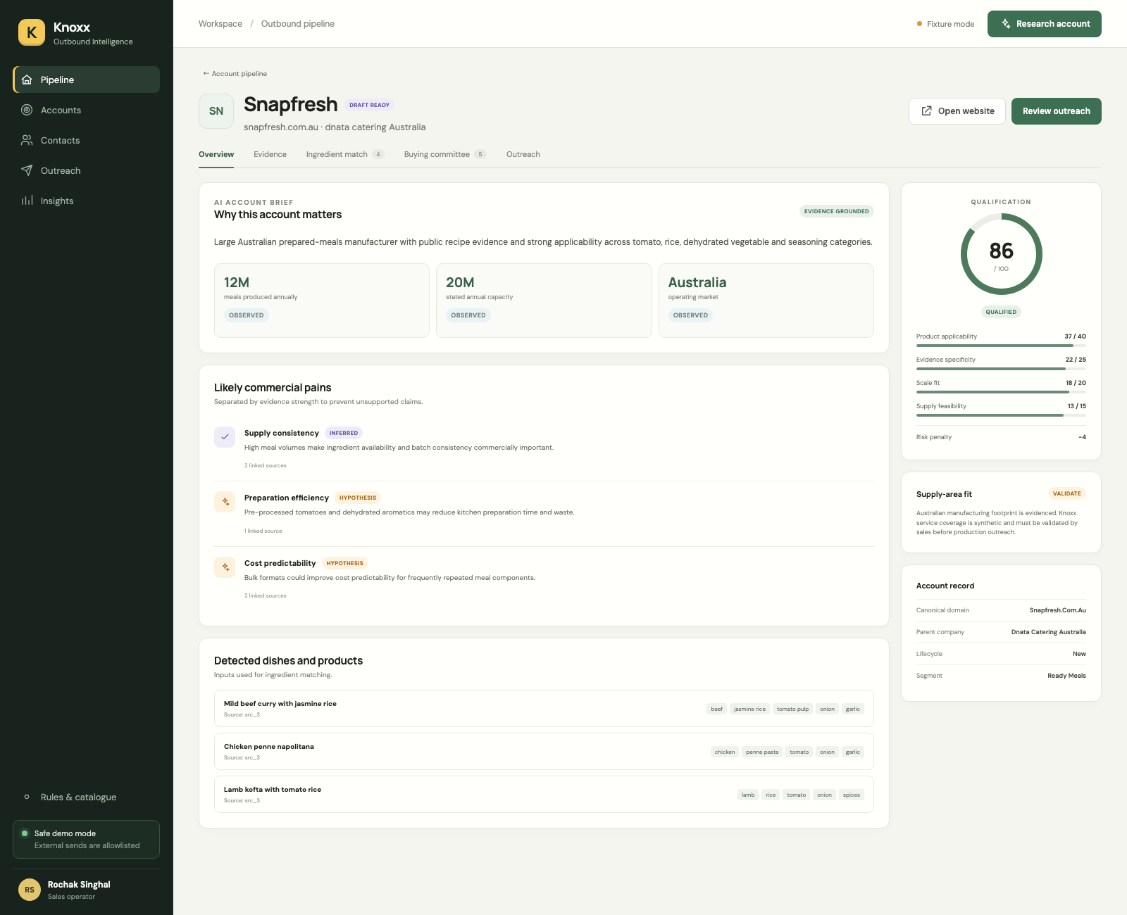
LIVE PROOF VS. GOLDEN FIXTURE
What is accurate, actionable and still a hypothesis?
ACTIONABLE NOW
Account/run identity, ranked contacts, safe sequence, click/reply events and organization stop.
USE WITH A LABEL
Scale, dishes, ingredient overlap and quantity ranges when linked to retained evidence.
SALES MUST VALIDATE
Service region, capacity, MOQ, margin, claims, recipe share and the real economic buyer.
The screenshot is a golden expected-output fixture, not live Firecrawl persistence proof.
KNOXX OUTBOUND INTELLIGENCE
12

Slide 13
BOTTLENECKS AND IMMEDIATE CONTROLS
Q4 · What breaks at 1,000 domains?
BOTTLENECK
FAILURE MODE
CONTROL
Crawl
429s + long webhooks
Async jobs, Retry-After, page bounds, cache
LLM
Cost + bad JSON/claims
Bounded input, schema, repair once, escalate rarely
Apollo
Credits + plan limits
Search first; enrich top 1–2; live quota checks
n8n
Bursts + long waits
Queue mode, worker pools, provider backpressure
Postgres
Duplicates + contention
Idempotency, short transactions, indexes
Ops
Stuck runs look green
Checkpoints, traces, alerts, DLQ + replay
KNOXX OUTBOUND INTELLIGENCE
Firecrawl errors/crawl · Apollo rate limits/credits · n8n queue mode
13

Slide 14
SCALE AND COST
Enterprise target: accept → queue → checkpoint → notify
Return 202 + run_id in under one second; never wait for crawling in the user request.
ILLUSTRATIVE CAPACITY
1,000 / 480 minutes ≈ 2.1 jobs/min. At 3 worker-minutes/job: ≈ 6.3 average concurrency; provision ~10–15 slots for variance.
Use durable jobs for retrieval, extraction, scoring, contacts and drafts—each with an idempotency key.
Separate worker pools and rate budgets for Firecrawl, LLM and Apollo; retry transient failures, DLQ exhausted jobs.
Cache evidence by content hash/freshness; reprocess only when evidence, catalogue or rule versions change.
STRONGEST COST CONTROL
If 30% reuse fresh evidence, plan 700 full runs + 300 revalidations—not 1,000 full crawls.
Measure cost per started, completed and qualified account—not an invented per-request promise.
KNOXX OUTBOUND INTELLIGENCE
14

Slide 15
CPO decision: fund a controlled pilot
The product addresses account prioritization—not vanity automation.
PORTFOLIO HANDOFF
Architecture source Gamma-ready deck Lovable master prompt Workflow + interview guide Verification report
AI judgment is bounded by evidence, deterministic controls and human approval.
The downstream click/reply/organization-stop loop has live proof.
Production is blocked on live crawl persistence, sales policy, RLS/load and compliance checks.
Next: a 25-account assisted pilot measuring speed, precision, trust and cost per accepted account.
Questions
KNOXX OUTBOUND INTELLIGENCE
15

